Slide 1
Endocrine Glands

Slide 2
What are we doing today?
Hormones secreted from the hypothalamus, pituitary, thyroid, parathyroid, pancreas and adrenal glands are involved in homeostasis by affecting specific target organs (SU)
The secretions of the pituitary gland are controlled by the hypothalamus through transport of hormones, either via nerve cells or the vascular link between them (SU)
The hypothalamus, pituitary, thyroid, parathyroid, pancreas, thymus, gonads, pineal and adrenal glands, are endocrine glands found in the human body (SU)

Slide 3
Keywords
Endocrine gland:
Hormone:
Target cells/organ:
Negative feedback:

Slide 4
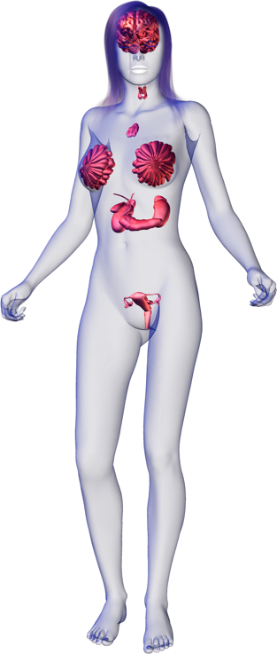
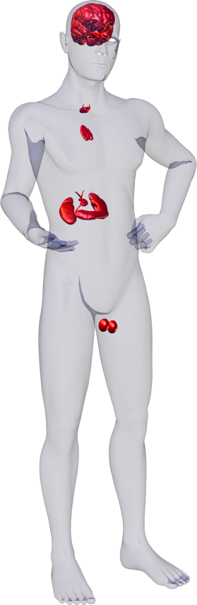
Endocrine Glands
2
Adrenal glands
5
1
6
7
10
2
Hypothalamus
9
1
Ovaries (female)
3
4
Pancreatic islets
4
5
Parathyroid glands
3
8
6
Pineal
7
Pituitary gland
8
Testes (male)
9
Thymus gland
10
Thyroid gland

Slide 5
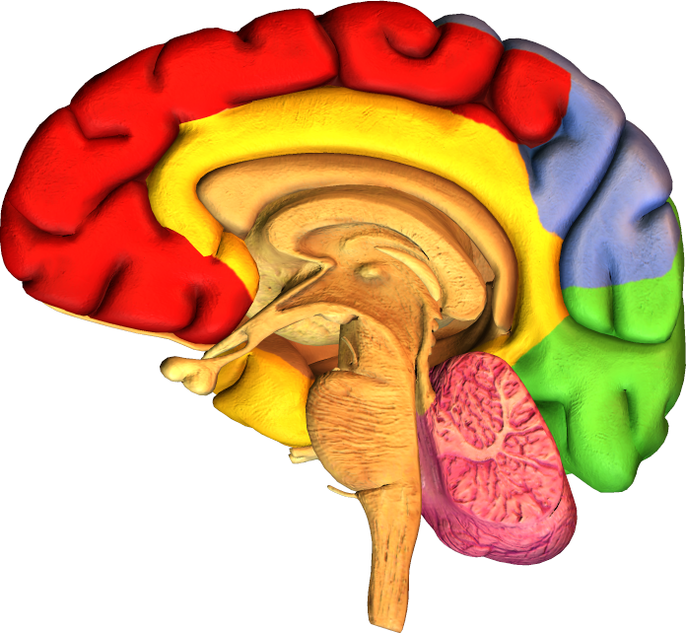
Hypothalamus
The hypothalamus is located below the thalamus, just above the brainstem and pituitary gland.
It receives information from sensory receptors and uses this information to to control and integrate many basic physiological activities, including:
temperature regulation
food and fluid intake
sleep
Hypothalamus

Slide 6
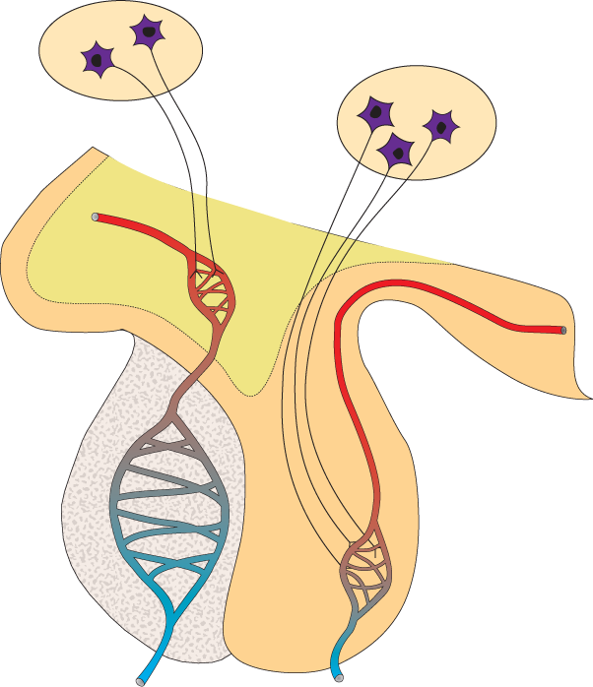
Role of the Hypothalamus
Neurosecretory cells
One of the most important functions of the hypothalamus is to link the endocrine system to the nervous system via the pituitary.
The hypothalamus contains neurosecretory cells.
These are specialized secretory neurons, which are both nerve and endocrine cells.
Hypothalamus
Anterior pituitary
(adenhypophysis)
Posterior pituitary(neurohypophysis)
Structure of hypothalamus and pituitary

Slide 7
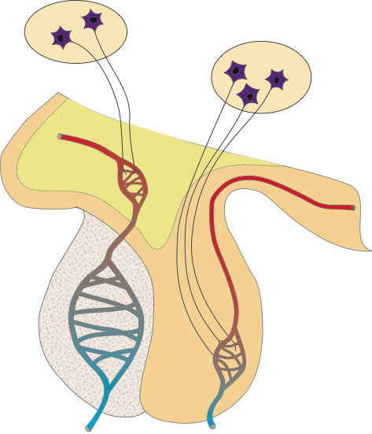
Hypothalamus Structure
Neurosecretory cells in the hypothalamus secrete neurohormones into capillaries. These releasing hormones control the release of hormones from the anterior pituitary.
Neurohormones from the hypothalamic neurosecretory cells supplying the posterior pituitary.
Artery
Portal vein links two capillary networks
Neurosecretory axons
Anterior pituitary is truly glandular and secretes hormones in response to the hypothalamic hormones.
Posterior pituitary is neural in origin
Releases at least seven peptide hormones, including GH, TSH, and ACTH
Stores and releases oxytocin and ADH produced by the hypothalamus.

Slide 8
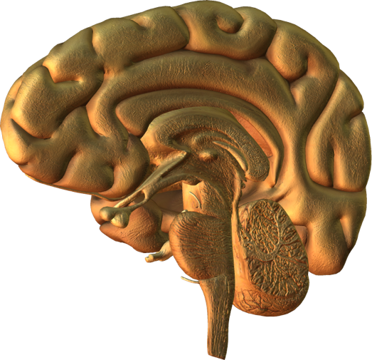
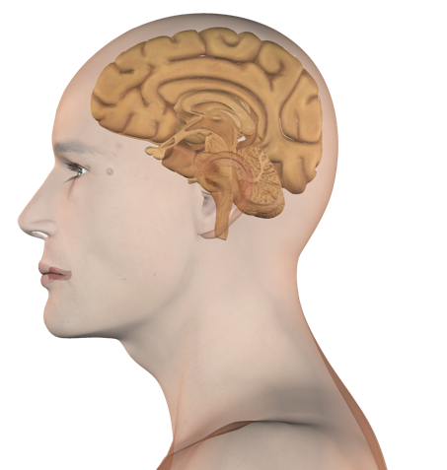
Hypothalamus
The hypothalamus coordinates nervous and endocrine systems.
It secretes releasing hormones, which regulate the hormones of the anterior pituitary.
It also produces the neurohormones oxytocin and ADH, which are transported to and released from the posterior pituitary.
hypothalamus

Slide 9
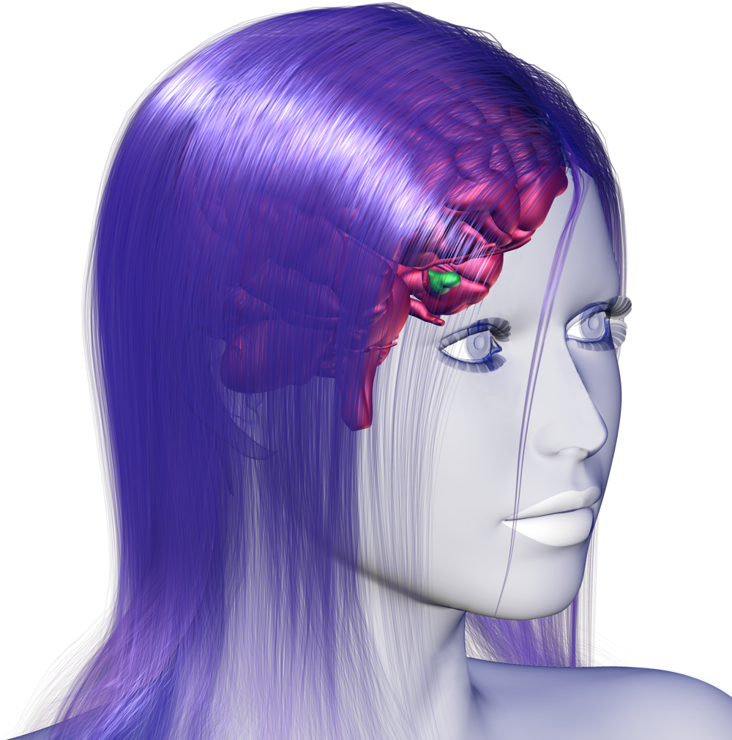
Hormones of the Pituitary
The pituitary gland is an endocrine gland about the size of a pea hanging from the inferior surface of the hypothalamus.
It pituitary comprises two distinct regions:
Anterior pituitary: glandular in origin
Posterior pituitary: neural in origin (an extension of the hypothalamus)
Posterior pituitary
Anterior pituitary

Slide 10
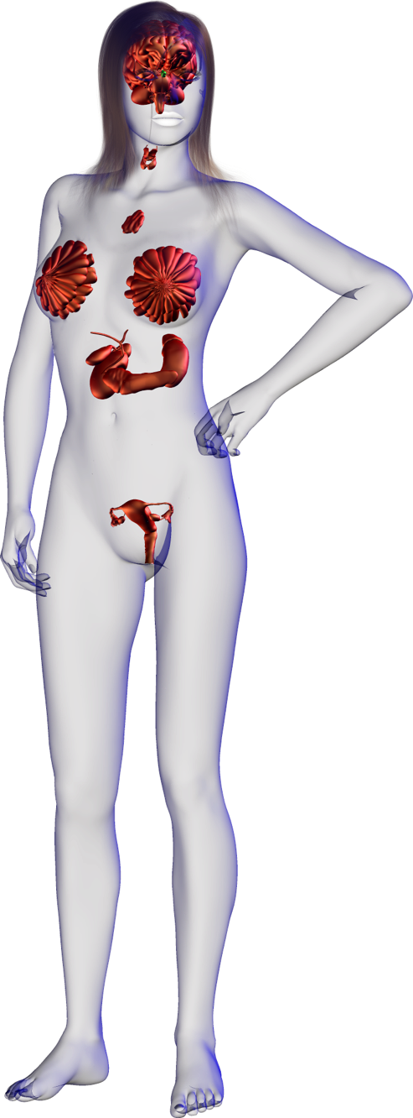
Anterior Pituitary
Thyroid Stimulating Hormone
Increases synthesis and secretion of thyroid hormones T3 and thyroxine) from the thyroid gland.
The anterior pituitary releases at least seven peptide hormones into the blood.
The release of these hormones is regulated by releasing and inhibiting hormones from the hypothalamus.
Growth Hormone
Stimulates protein synthesis and growth in most tissues. One of the main regulators of metabolism.
Adrenocorticotrophic Hormone
Usually abbreviated to ACTH, this hormone increases synthesis and secretion of hormones (aldosterone and cortisol) from the adrenal cortex.
Prolactin
Stimulates growth of the mammary glands and synthesis of milk protein.
Follicle Stimulating Hormone
In females: Stimulates maturation of the ovarian follicles.
In males: Increase the production of sperm in the seminiferous tubules
Luteinizing Hormone
In females: Stimulates secretion of ovarian hormones, ovulation, and formation of the corpus luteum.
In males: (ICSH) Stimulates synthesis and secretion of testosterone.
Melanophore Stimulating Hormone
Increases melanin synthesis and dispersal in the skin’s melanocytes.

Slide 11
Posterior Pituitary
The posterior pituitary develops as an extension of the hypothalamus.
The release of its two hormones oxytocin and antidiuretic hormone occurs directly as a result of nervous input to the hypothalamus.
Oxytocin
Acts on the mammary glands to stimulate milk ejection (let down).
Antidiuretic Hormone (ADH)
Acts on the collecting duct of the kidney to increase water reabsorption from the filtrate (urine).
Oxytocin
Acts on the uterus to stimulate smooth muscle contraction during labor.

Slide 12
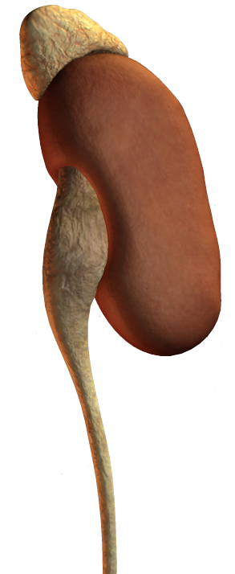
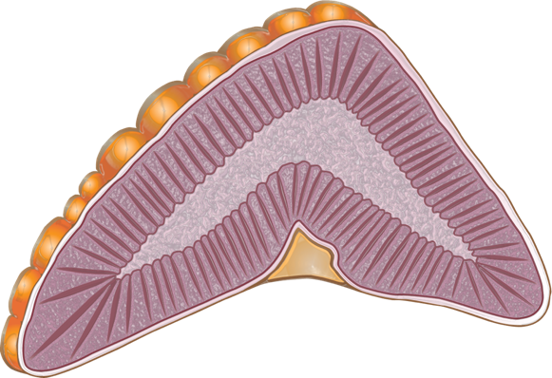
Adrenal Glands
Adrenal gland
The adrenals (also known as the suprarenal glands) are located on the superior surface of the kidneys.
The adrenal medulla produces epinephrine(adrenaline) and norepinephrine (noradrenaline), involved in the fight of flight response.
The adrenal cortex produces various steroid hormones including:
cortisol (response to stress)
aldosterone (sodium regulation)
Medulla
Kidney
Cortex

Slide 13
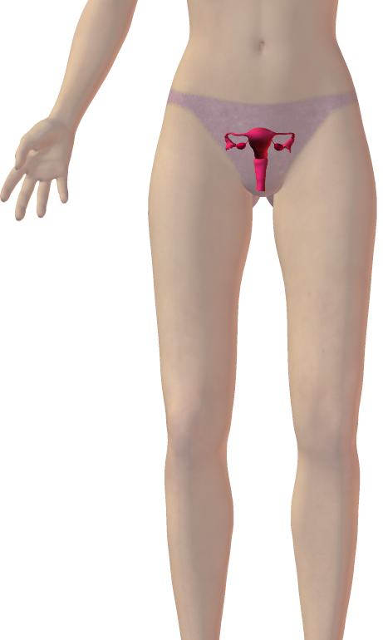
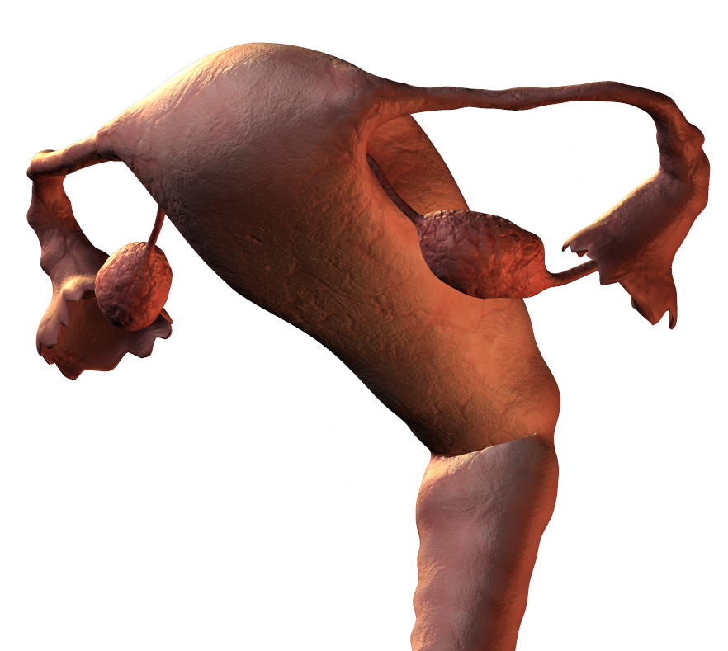
Ovaries (Females)
The ovaries are both endocrine glands and gonads, located in the lateral wall of the pelvis on either side of the uterus.
The ovaries produce estrogen and progesterone.
These hormones control and maintain:
female characteristics
stimulate menstrual cycle
maintain pregnancy
prepare the mammary glands for lactation
Ovaries

Slide 14
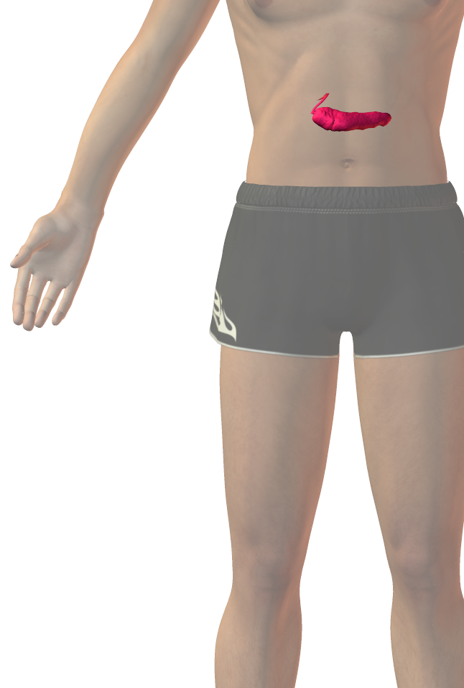
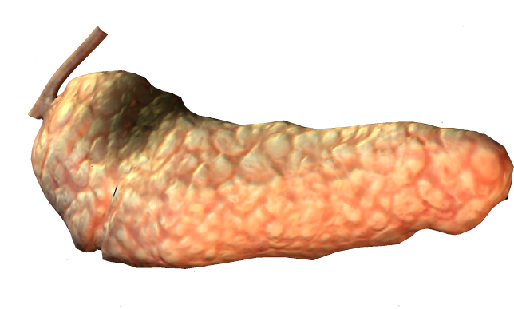
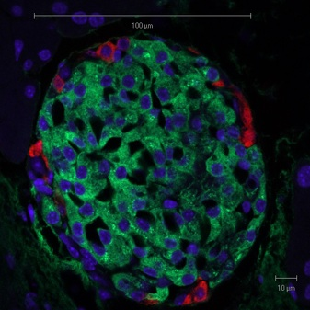
Pancreatic Islets
The endocrine portion of the pancreas is called the islets of Langerhans. The islets are scattered throughout the pancreatic tissue.
Each islet is about 0.2 mm in diameter.
Specialized α cells and β cells in the islets of Langerhans produce insulin and glucagon respectively.
Together, these control blood sugar levels.
Insulin (green)
Glucagon (red)
Solimena Lab, Med. Fac., University of Technology, Dresden, Germany CC 3.0
Cell nuclei (blue)
Pancreas
Islet of Langerhans

Slide 15
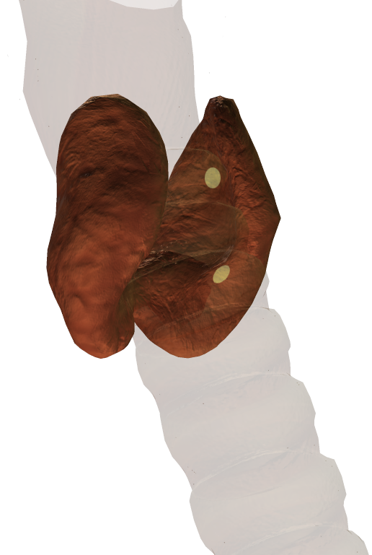
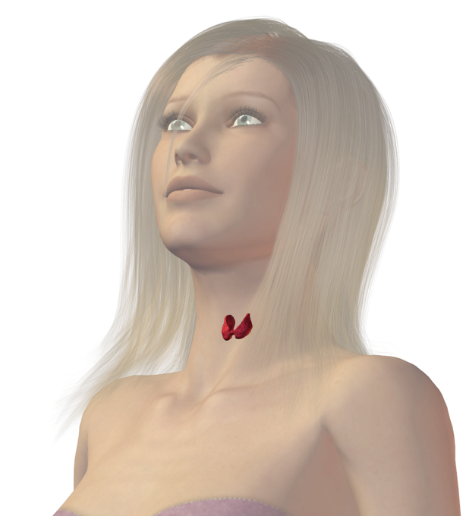
Parathyroids
These are located on the posterior surface of the thyroid gland.
Parathyroid glands secrete PTH (parathyroid hormone) which regulates blood calcium levels and promotes release of calcium from bone.
High levels of calcium in the blood inhibit PTH secretion.
Parathyroid glands (on posterior of thyroid)
Trachea

Slide 16
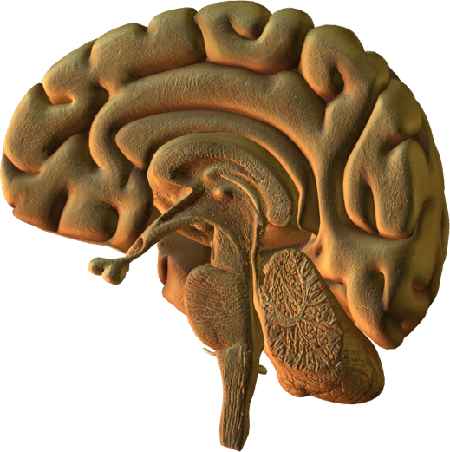
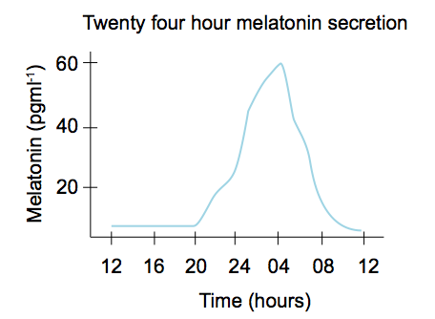
Pineal Gland
This small gland in the brain secretes melatonin, which regulates the sleep-wake cycle.
Melatonin secretion follows a circadian rhythm and coordinates reproductive hormones too.
Pineal gland

Slide 17
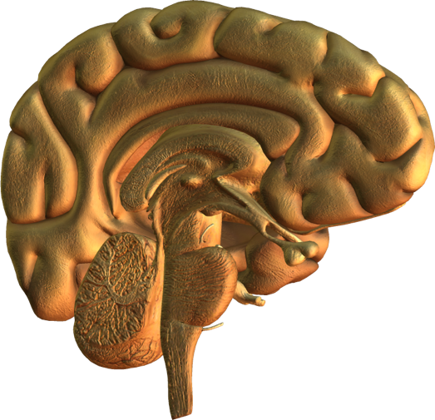
Pituitary Gland
The pituitary is located below the hypothalamus.
It secretes at least nine hormones that regulate the activities of other endocrine glands.
Secretions of the anterior pituitary are regulated by releasing hormones from the hypothalamus.
Anterior pituitary
Posterior pituitary

Slide 18
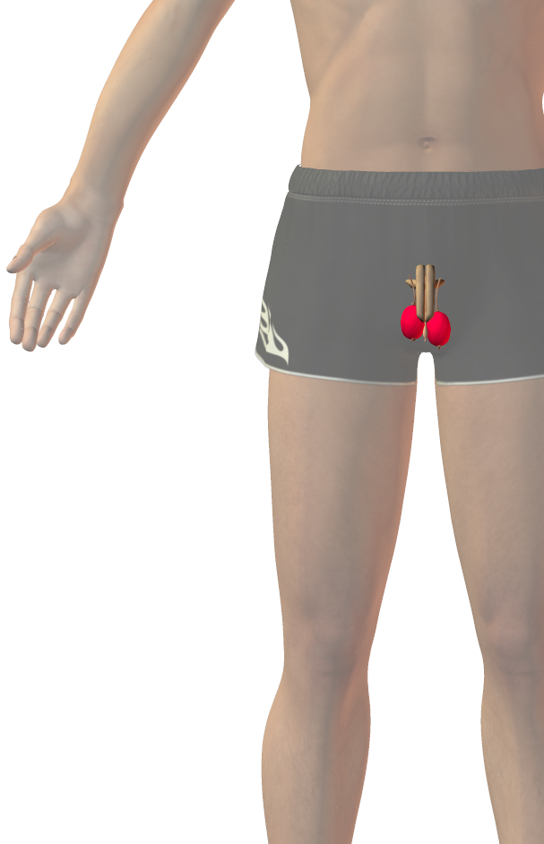
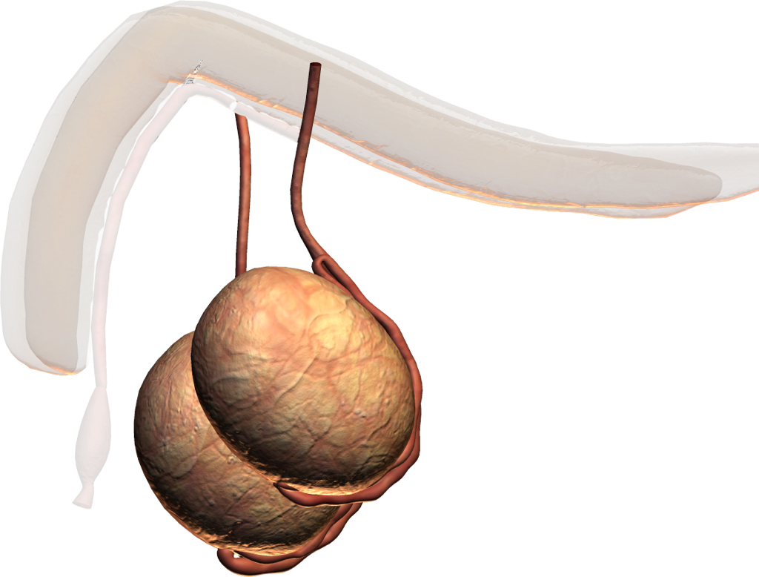
Testes (Males)
Like the female ovaries, the testes are both endocrine organs and gonads.
The testes are supported below the torso in an extension of the abdomen called the scrotum.
The testes produces testosterone, which:
Controls and maintains: “maleness” (muscular development and deeper voice)
Promotes sperm production
Testis functions are regulated by gonadotropic hormones produced by the anterior pituitary.
Testes

Slide 19
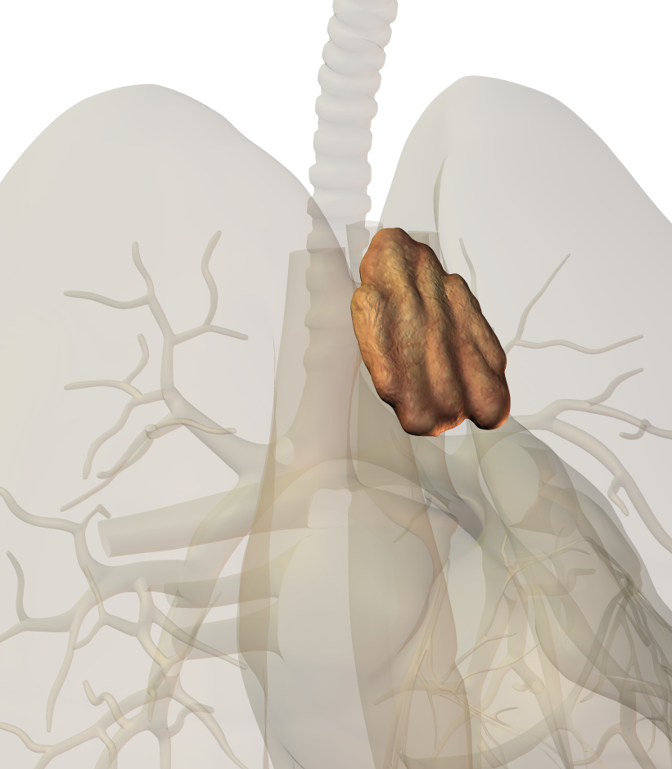
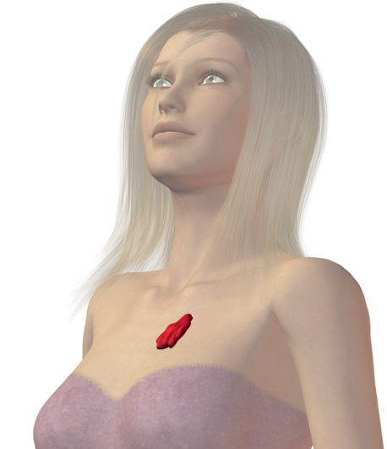
Thymus Gland
The thymus is a rather diffuse organ located in front of the heart and behind the sternum.
The thymus is large in infants, but decreases in size during adulthood.
The thymus produces thymosin that is essential for the development of T-lymphocytes and the immune system.
Thymus

Slide 20
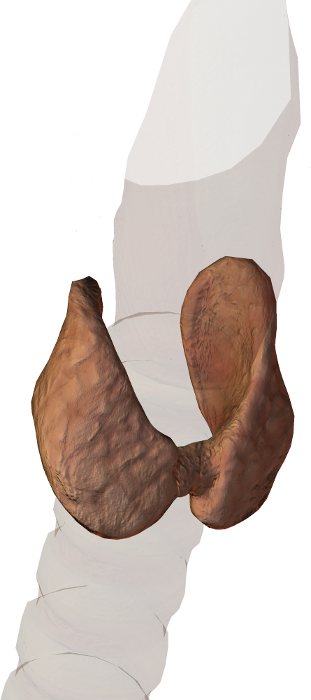
Thyroid Gland
The thyroid is a shield-shaped gland found in the neck below the thyroid cartilage, which forms the Adam’s apple.
The thyroid gland secretes thyroxine, and iodine containing hormone needed for normal growth and development.
Thyroxine stimulates metabolism and growth via protein synthesis.
Thyroid secretion is regulated by thyrid-stimulating hormone (TSH) from the anterior pituitary. TSH release is itself regulate by a hypothalamic releasing hormone.
Thyroid gland
Trachea

Slide 21
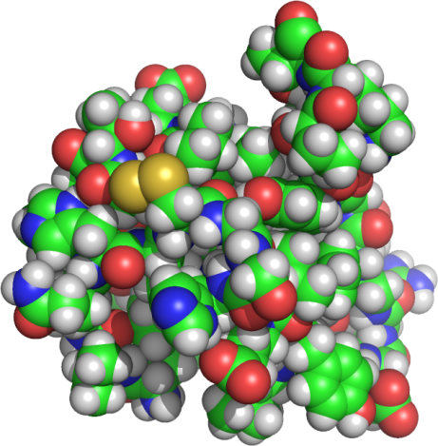
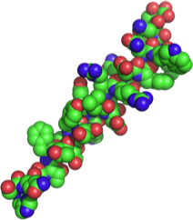
Antagonistic Hormones and Negative Feedback
The effects of one hormone are often counteracted by an opposing hormone.
Feedback mechanisms adjust the balance of the two hormones to maintain physiological function.
Example: insulin decreases blood glucose and glucagon raises it.
Raises blood glucose level
Increase in blood glucose stimulates insulin release
Decrease in blood glucose stimulates glucagon release
Glucagon
secretion
Insulin secretion
Lowers blood glucose level

